Slide 1

Lava Canyon: Map and Points of Interest

Slide 2
Reasons
Improve efficiency and speed of searches / rescues
Give us established names for places and points
Allow us to communicate using the same language
Guide those unfamiliar with the area
Improve safety of team members

Slide 3
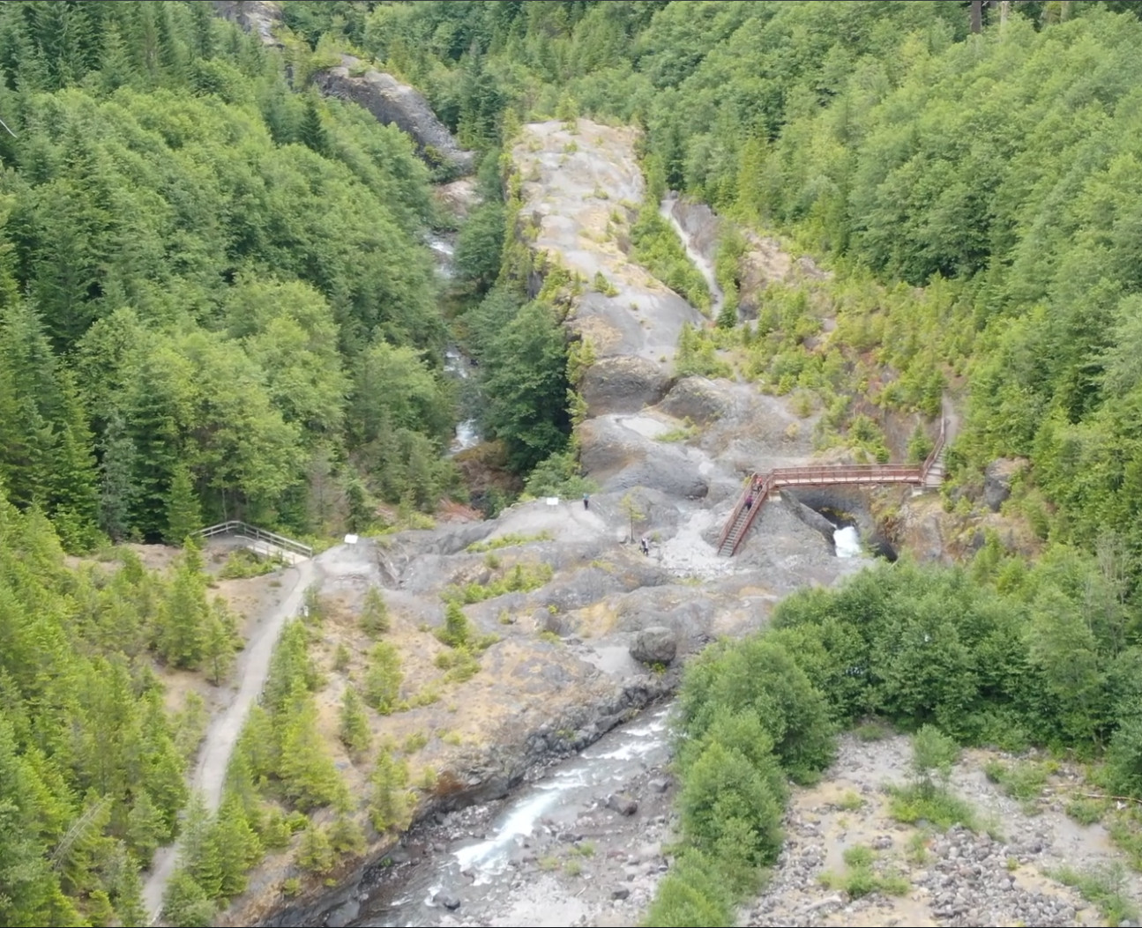
An Aerial Overview
Lava Canyon Fly Over

Slide 4
Considerations in Lava Canyon
Water level and flow rates change throughout the year
Visibility and lighting change throughout the day
Use PFDs and throw lines when crossing or near water
Use travel restricts near edges
Binoculars / optics are a big help
May need to set radios to simplex

Slide 5
Understanding the map
Waterfalls – blue circles and boxed text
Some waterfall names have been shortened
POI – red dot and boxed text
Paths – purple lines and boxed text
Viewpoints – diamond V
Pages of the map overlap

Slide 6
Waterfalls of Lava Canyon
Features of a waterfall
Total Height (includes all drops)
Tallest Drop
Number of Drops
Run (distance on ground between top and bottom)
Measurements are not exact but still useful
6 main waterfalls of Lava Canyon
2 more which the team on this project identified

Slide 7
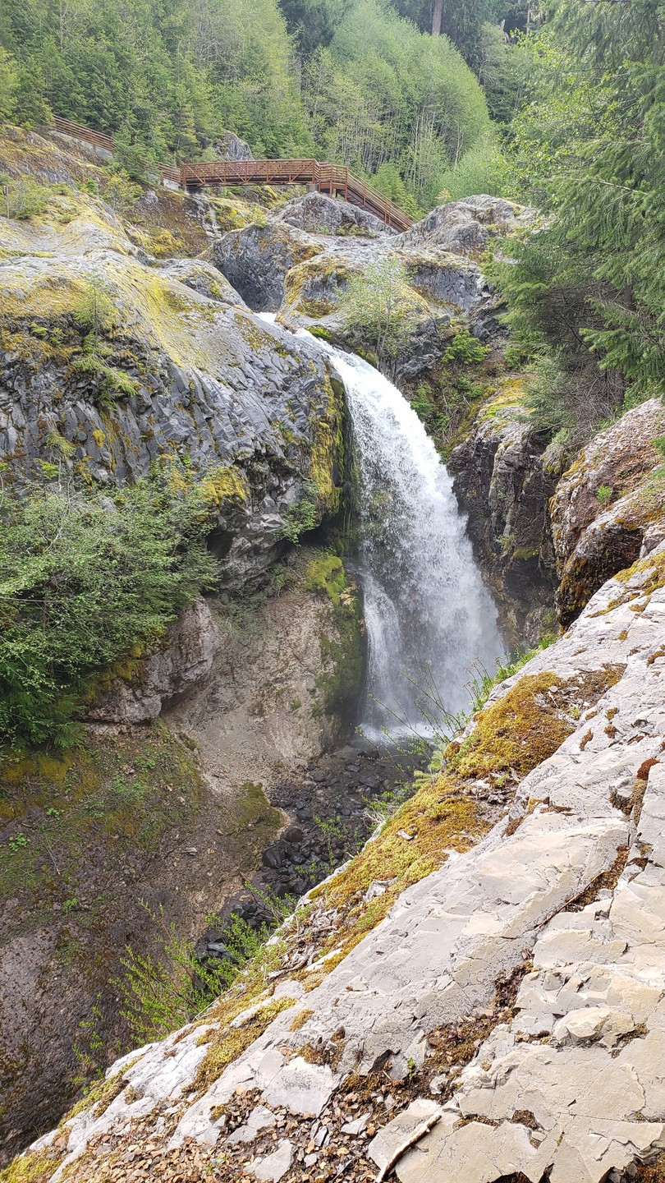
Upper Lava Canyon Falls
Total Height: 56 feet
Tallest Drop: 56 feet
Drops: 1
Run: 10 feet

Slide 8
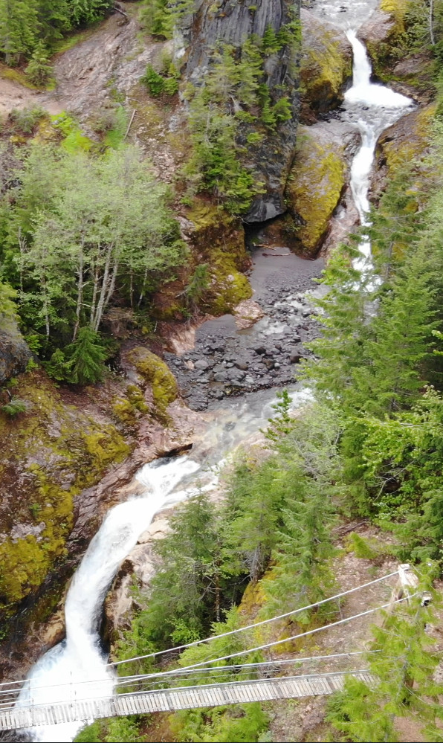
Triple Falls
Total Height: 56 feet
Tallest Drop: 24 feet
Drops: 3
Run: 100 feet

Slide 9
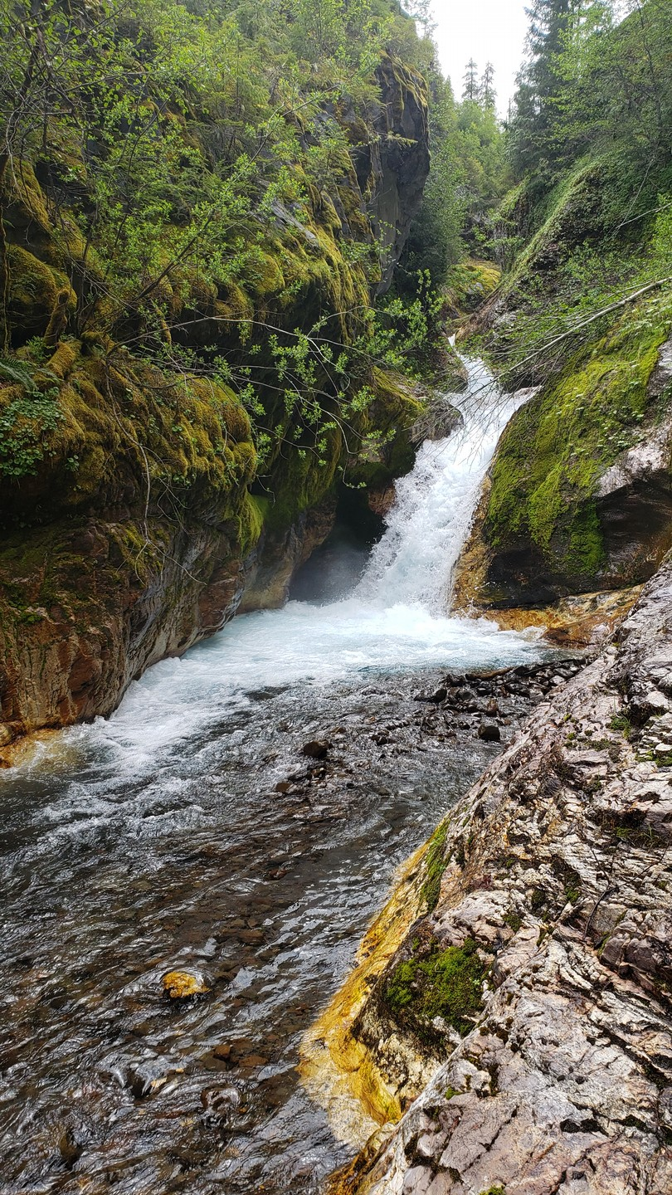
Twin Falls
Total Height: 34 feet
Tallest Drop: 18 feet
Drops: 2
Run: 30 feet

Slide 10
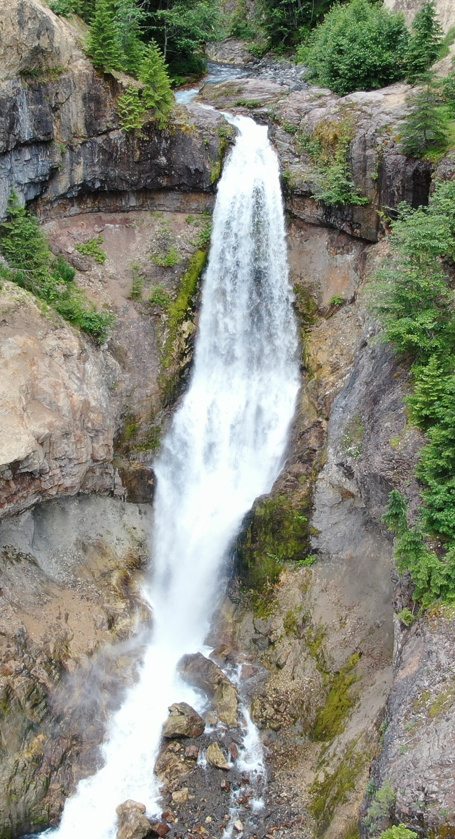
Lava Canyon Falls
Total Height: 132 feet
Tallest Drop: 132 feet
Drops: 1
Run: 40 feet

Slide 11
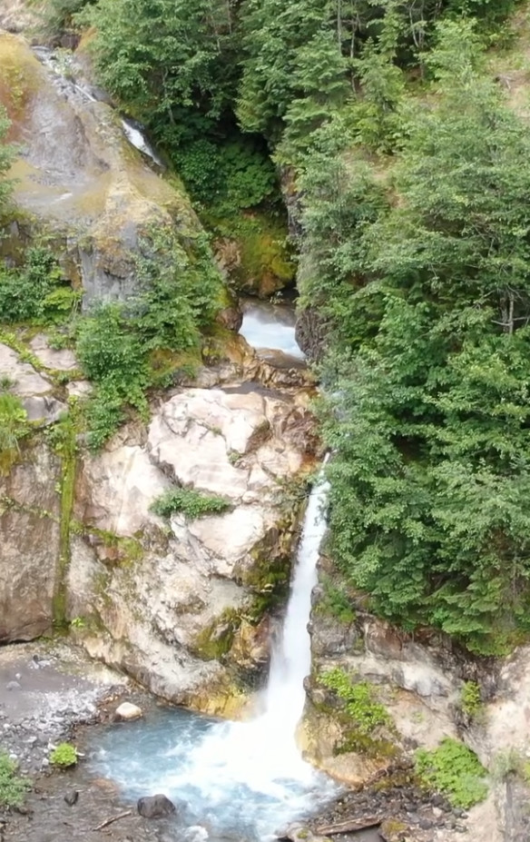
Middle Lava Canyon Falls
Total Height: 82 feet
Tallest Drop: 49 feet
Drops: 2
Run: 30 feet

Slide 12
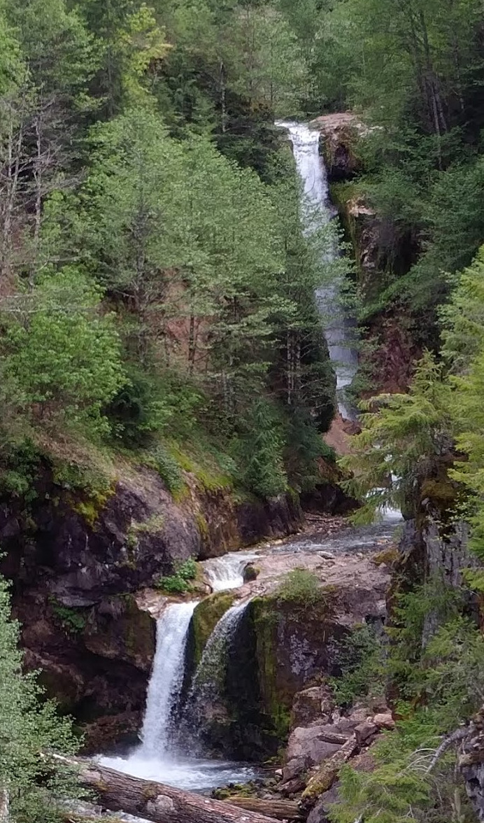
Lower Lava Canyon Falls
Total Height: 115 feet
Tallest Drop: 87 feet
Drops: 2
Run: 20 feet

Slide 13
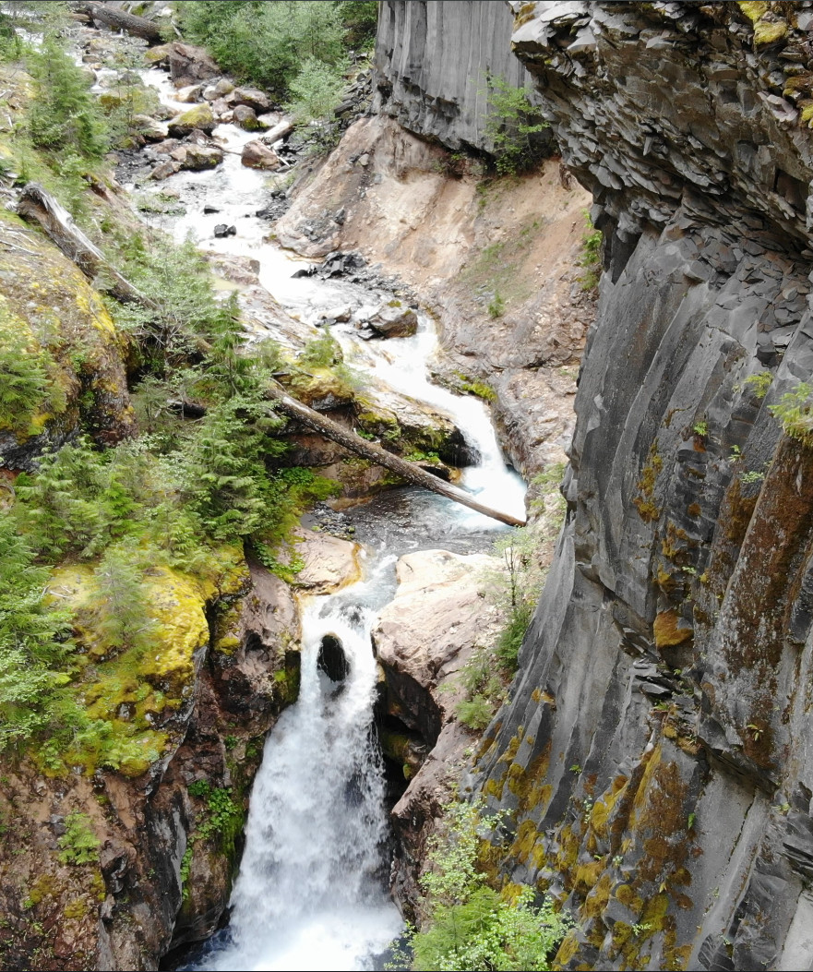
Ladder and Ship Falls
Total Height: ? feet
Tallest Drop: ? feet
Drops: 1 each
Run: ? feet

Slide 14
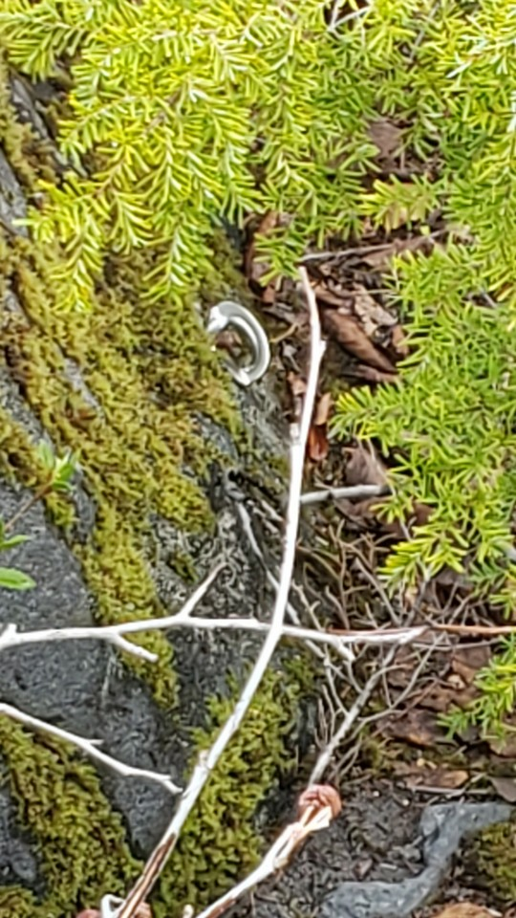
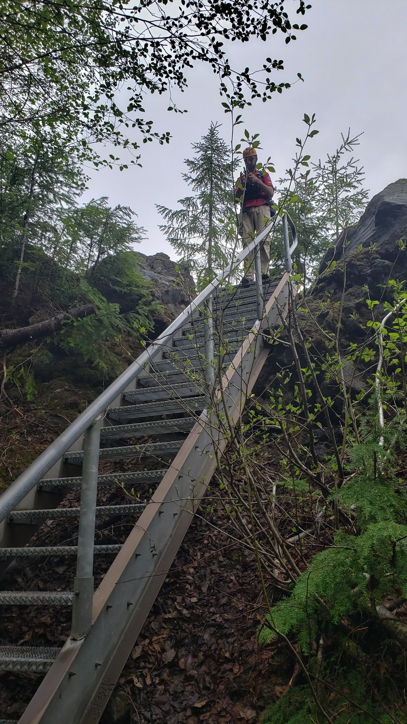
Lava Canyon Loop #184A

Slide 15
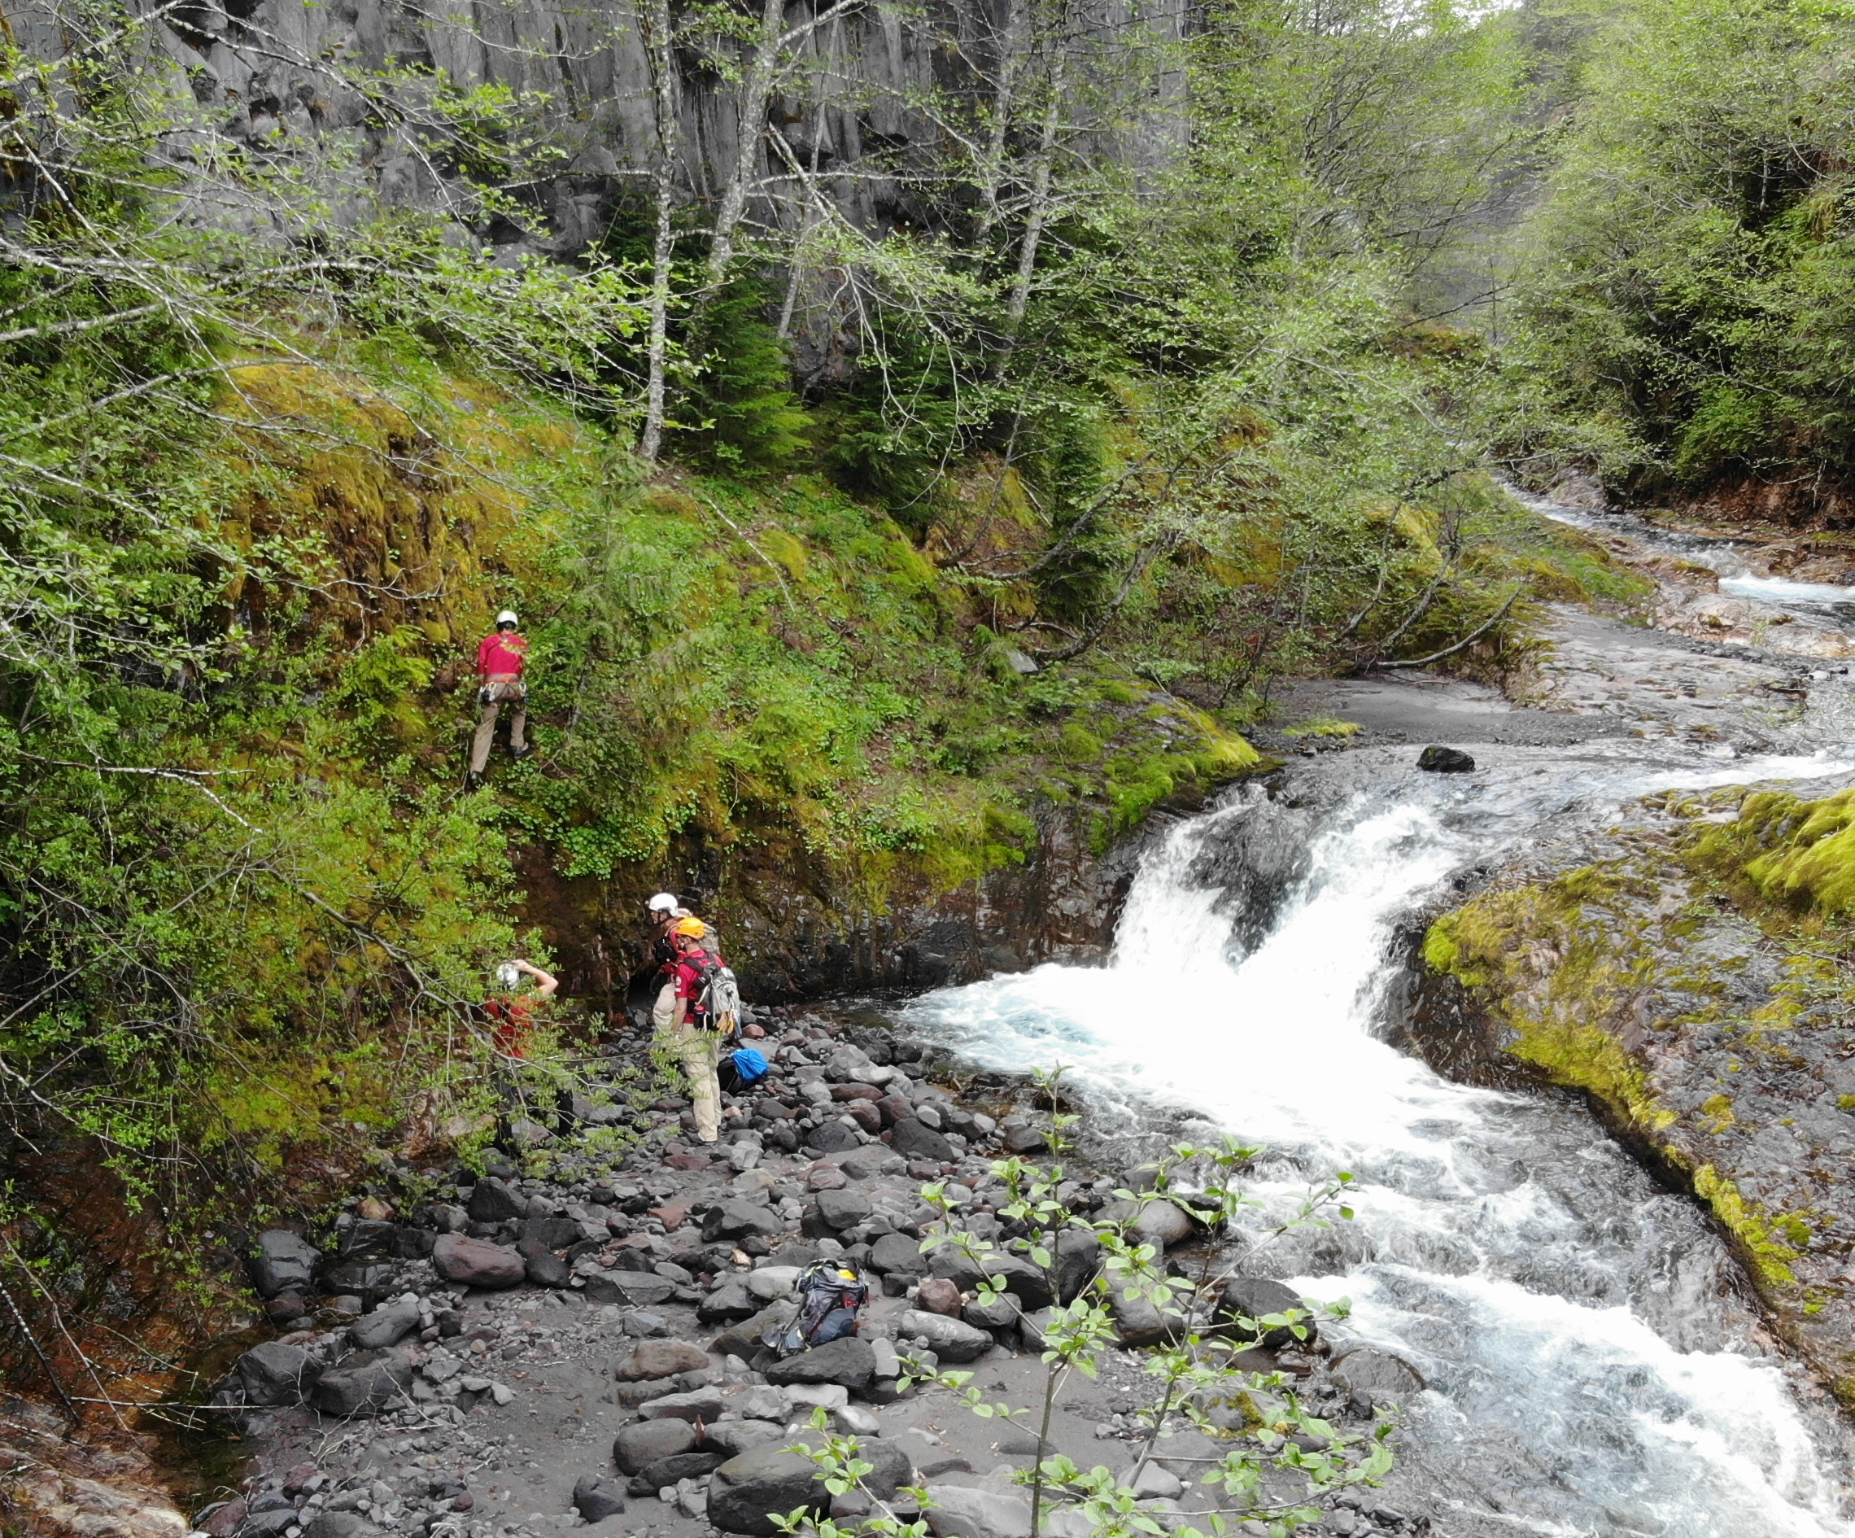
Lava Canyon Loop #184A
Triple Falls to Lava Canyon Falls

Slide 16
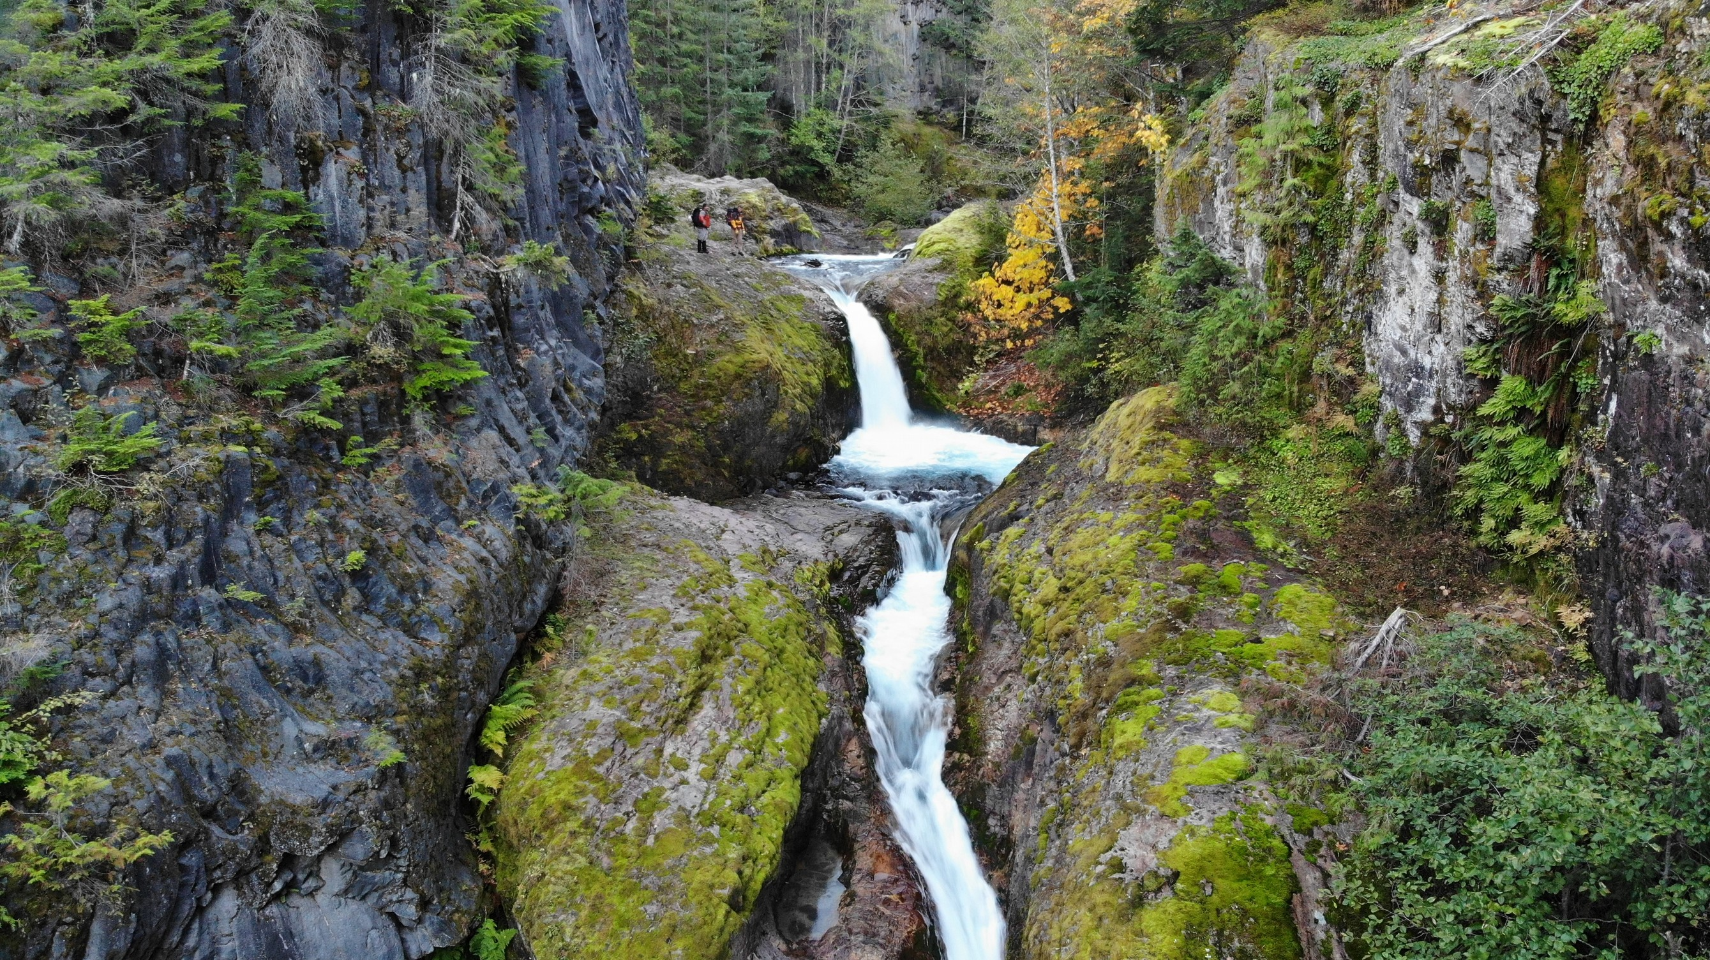
Lava Canyon Loop #184A
River View - East

Slide 17
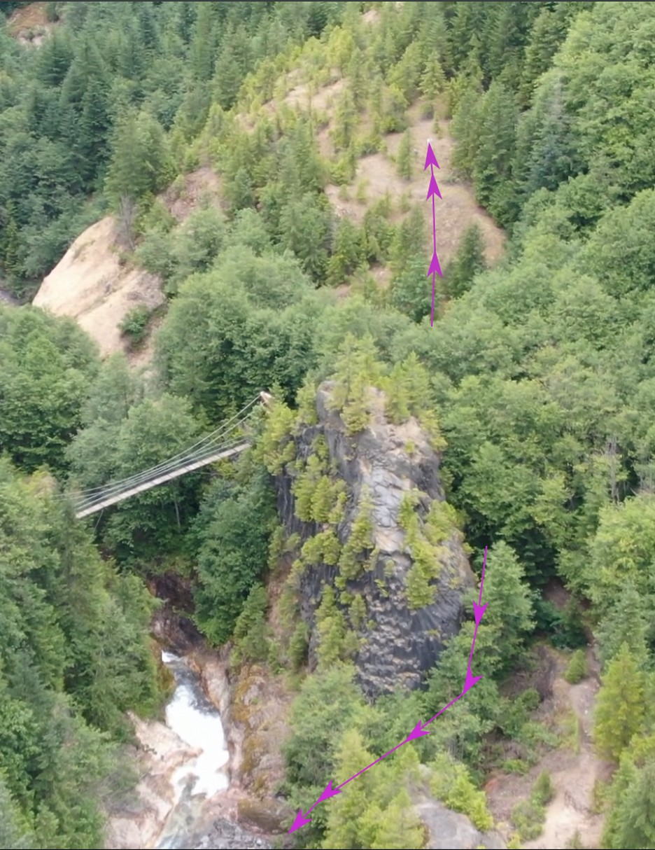
Lava Canyon Loop #184A
Bushwhack Trail
Start of trail is open
No views there though
River View East Trail
Easiest route hugs rock
Follows a ravine
Access to the middle of Triple Falls

Slide 18
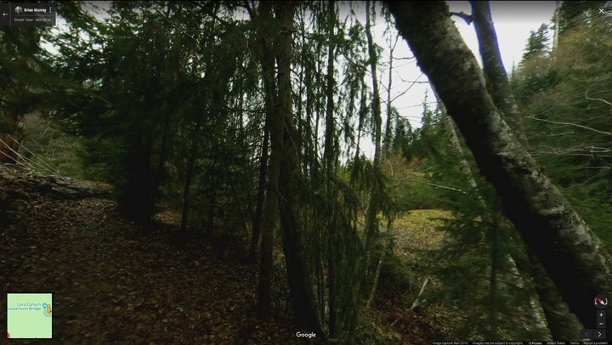
Bushwhack Trail
Entry point on Trail #184A

Slide 19
Bushwhack Trail
Useful for
Accessing base of Lava Canyon Falls
Viewing the upper tier of Middle Falls
Accessing the bottom of Middle Falls
A possible way out after the water crossing below Middle Falls

Slide 20
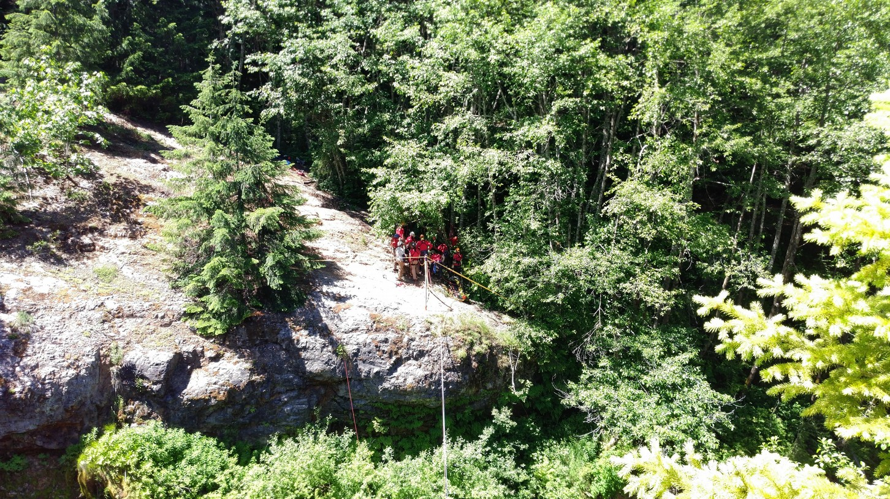
Lava Canyon Trail #184
Anchor Point West Side
Setup an Artificial High Directional here for training in June, 2018
Trees for anchors

Slide 21
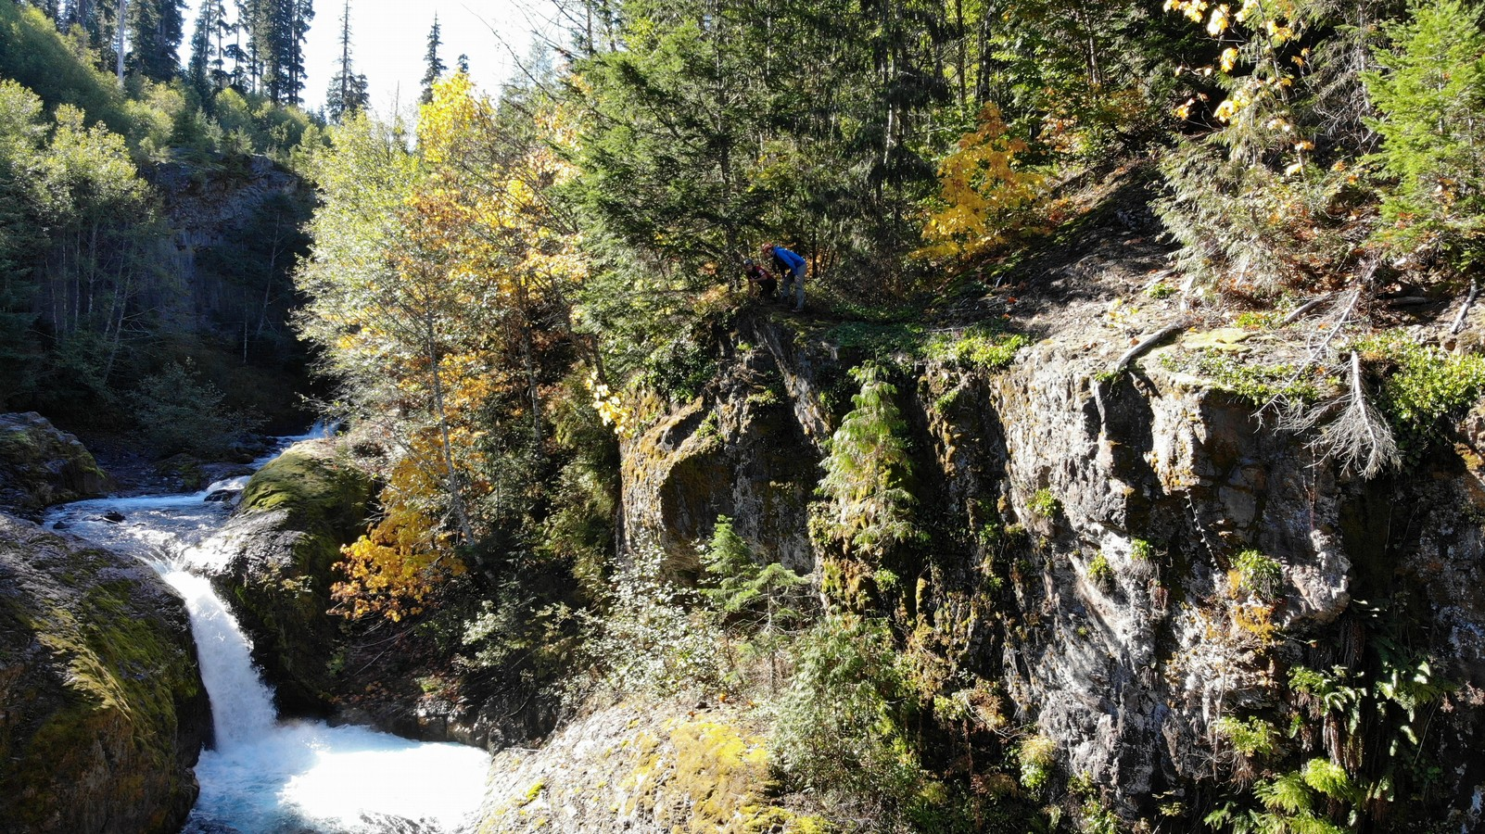
Lava Canyon Trail #184
River View - West

Slide 22
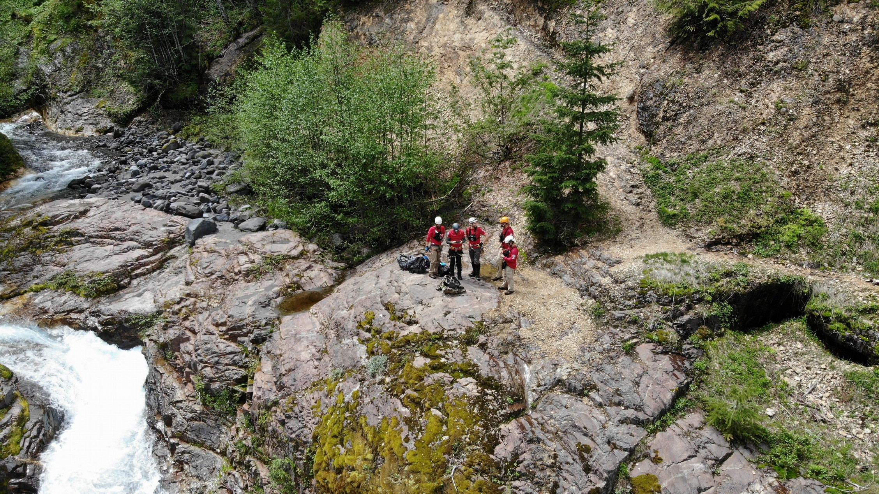
Trail #184 past suspension bridge
Stage Access point: above Lava Canyon Falls

Slide 23
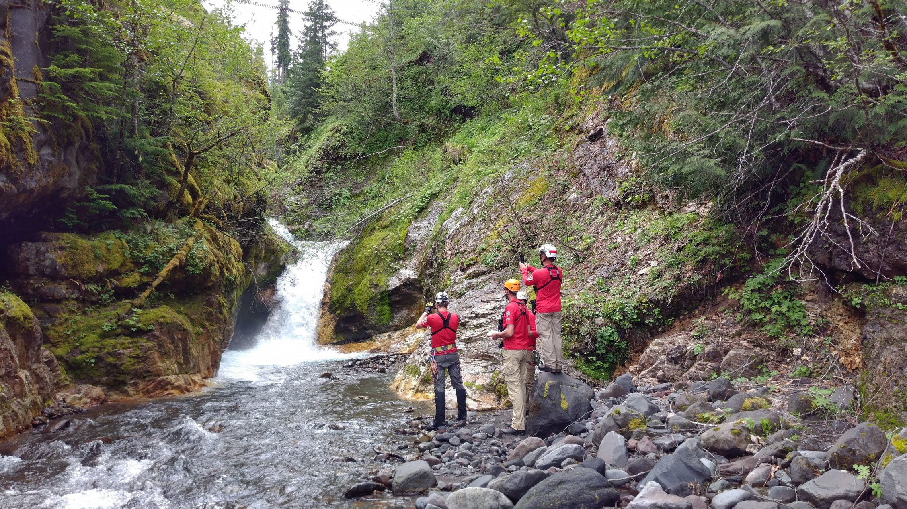
Trail #184 past suspension bridge
Stage Access point: view of Lower Twin Falls

Slide 24
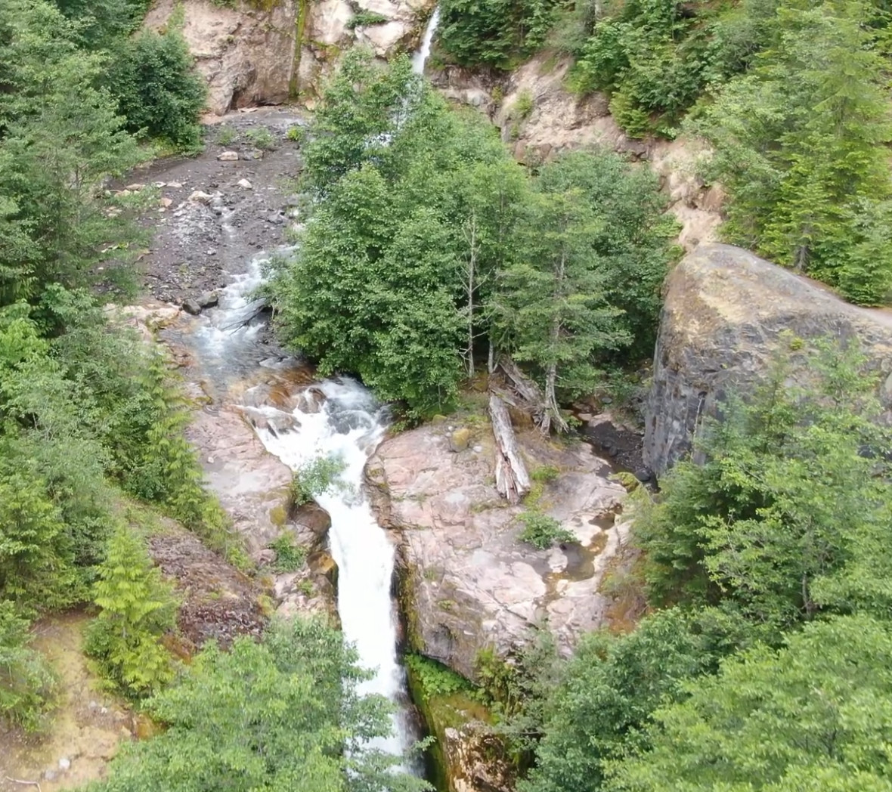
Trail #184 past suspension bridge
Lower Lava Canyon Falls to Middle Lava Canyon Falls

Slide 25
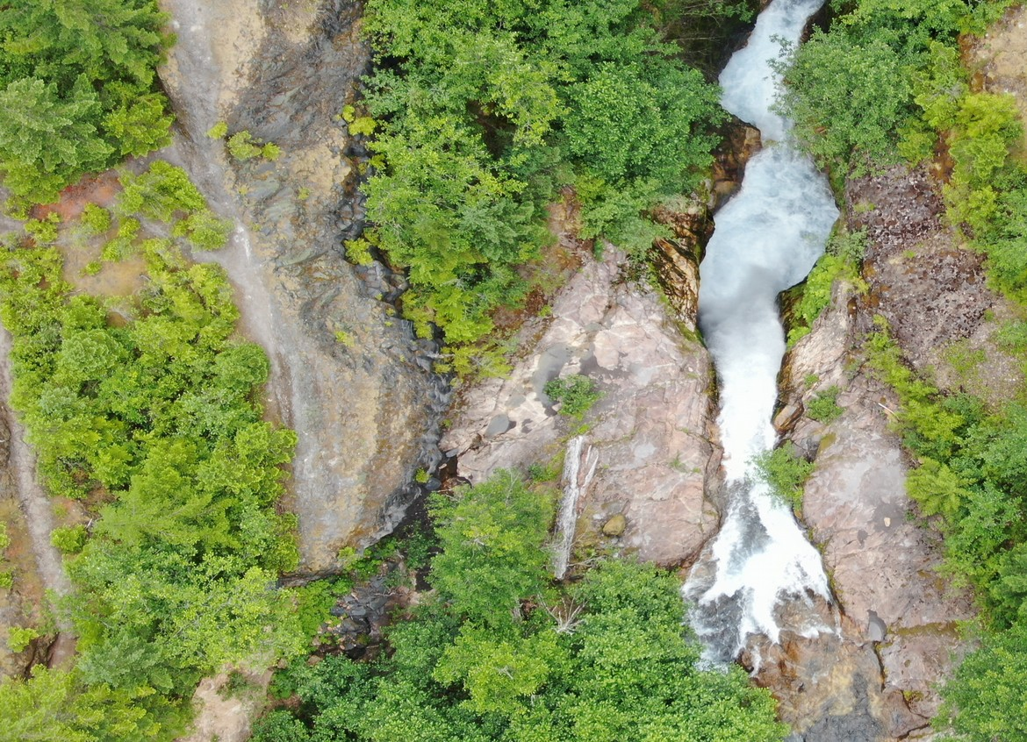
Trail #184 past suspension bridge
Aerial view of rappel point

Slide 26
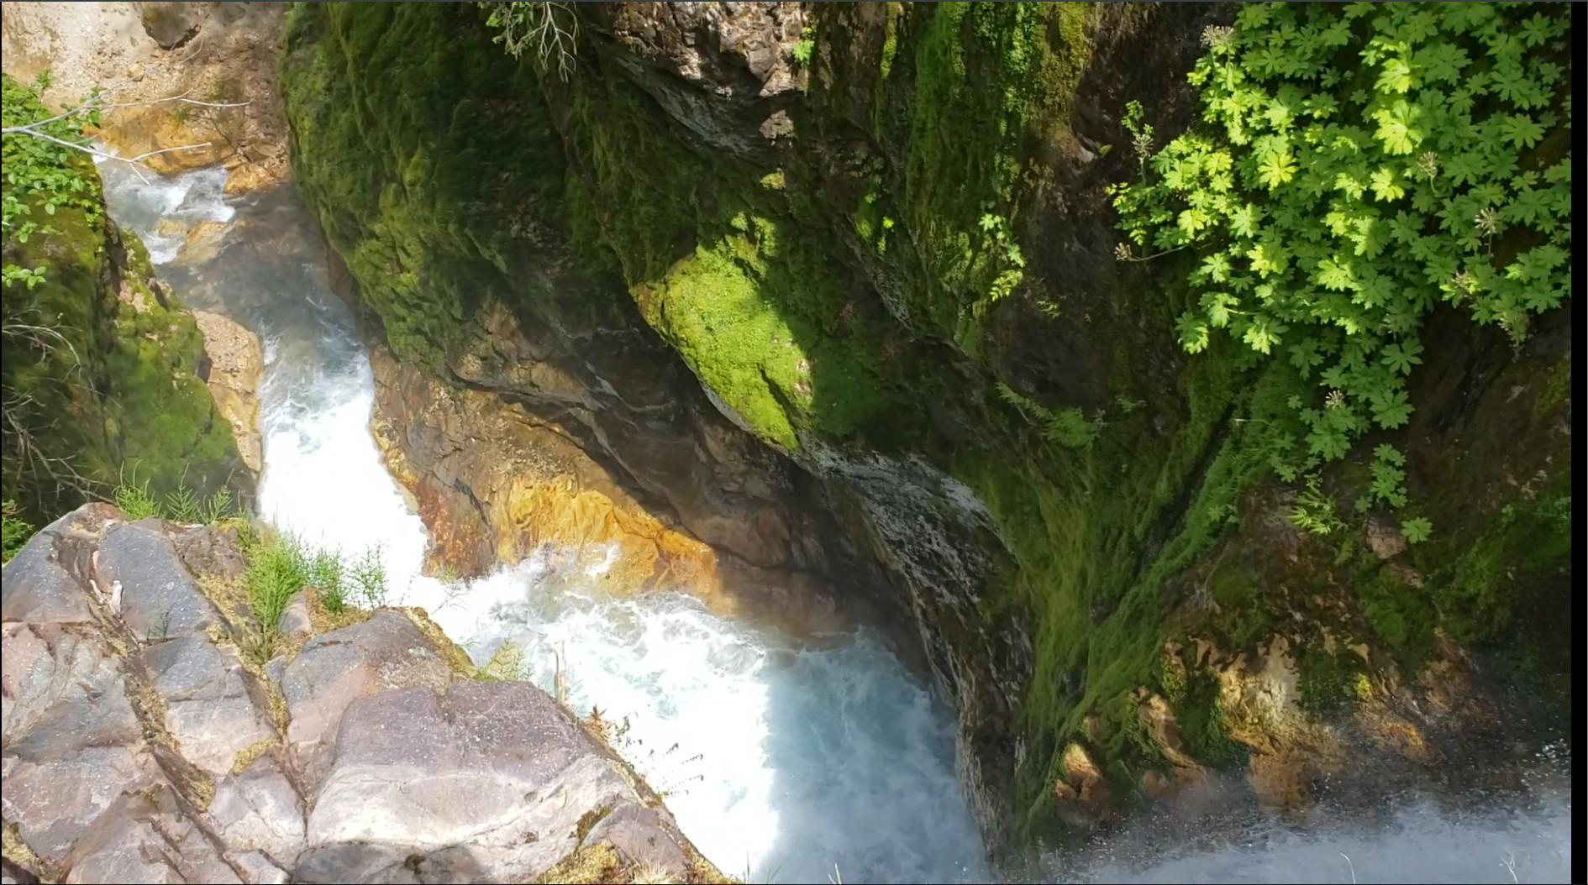
Trail #184 past suspension bridge
View from top of Lower Lava Canyon Falls

Slide 27
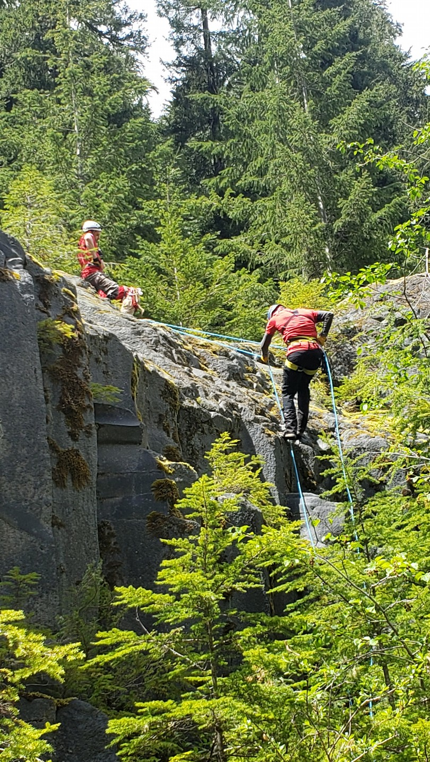
Trail #184 past suspension bridge
Rappel to water crossing and bottom of Middle Falls
Possible to climb up with a Prusik on the rappel line

Slide 28
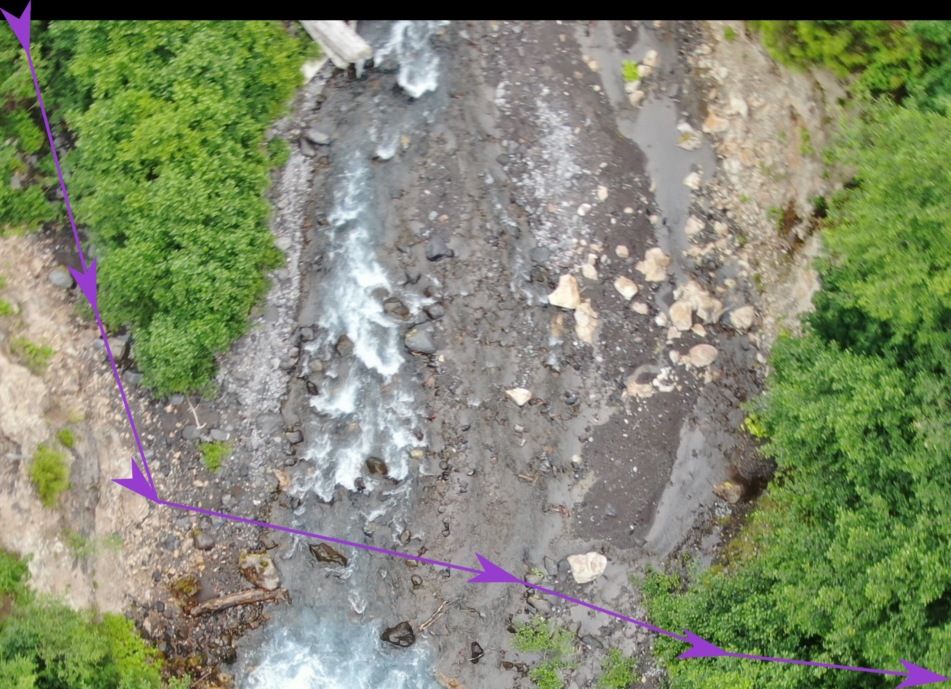
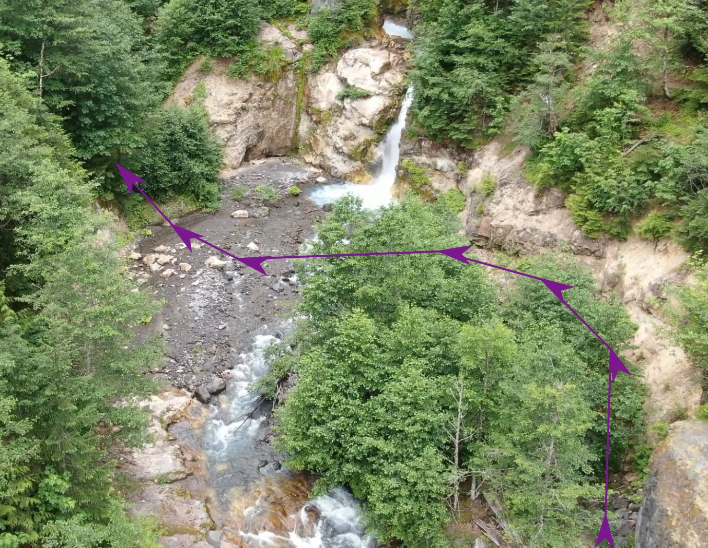
Trail #184 past suspension bridge
Route of water crossing

Slide 29
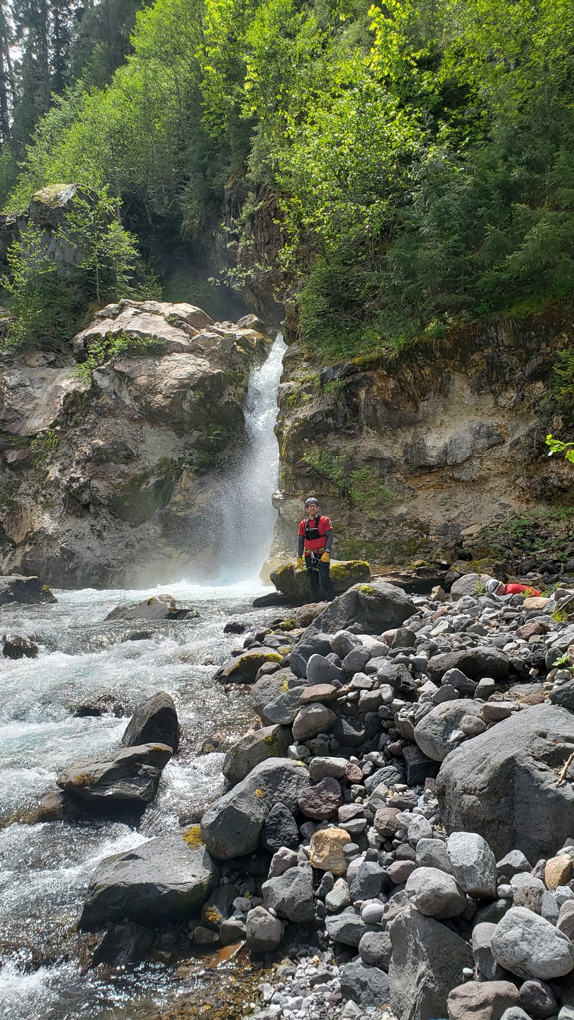
Trail #184 past suspension bridge
Bottom of 2nd tier of Middle Falls

Slide 30
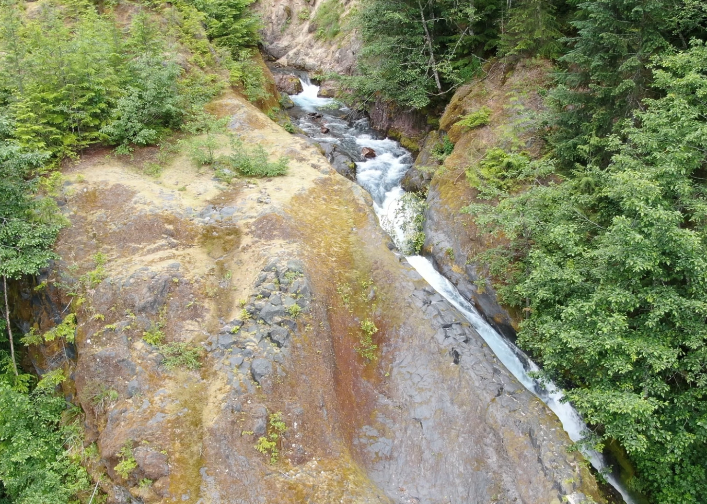
Trail #184 past suspension bridge
Destination for view of 1st tier of Middle Falls

Slide 31
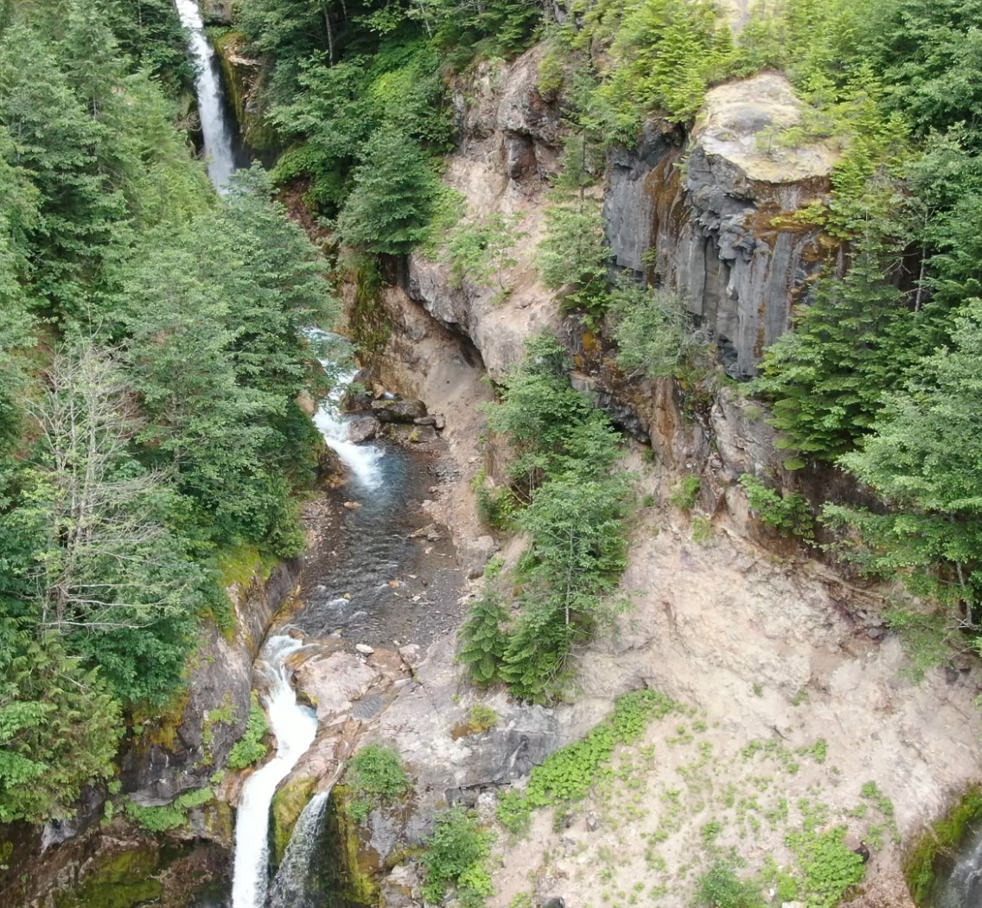
Trail #184 past suspension bridge
Video of view at access point past rappel point

Slide 32
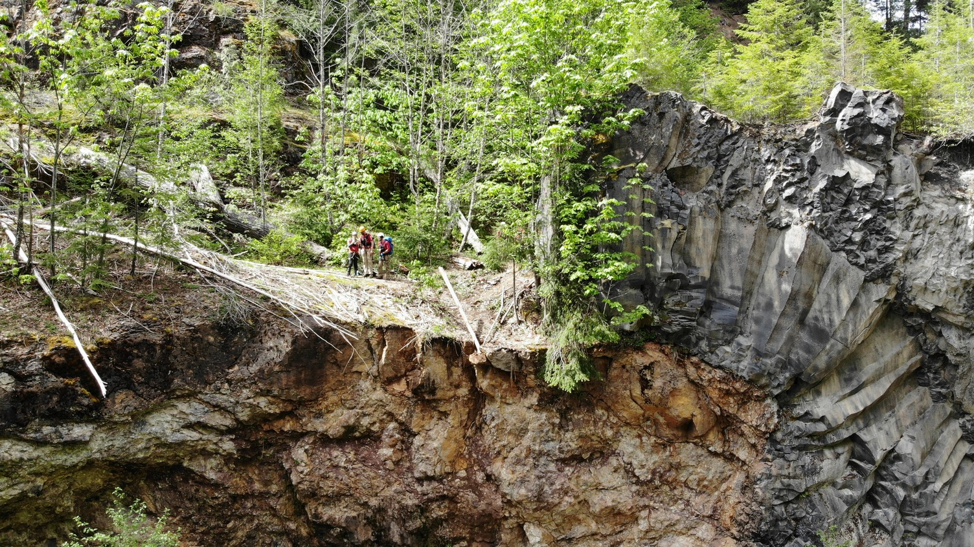
Trail #184 past suspension bridge
View near the Ladder

Slide 33
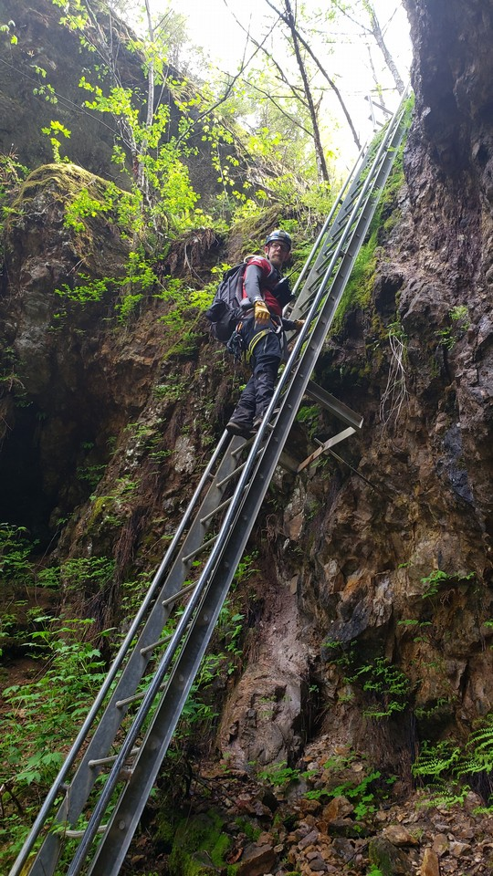
Trail #184 past suspension bridge
The Ladder
Decision point

Slide 34
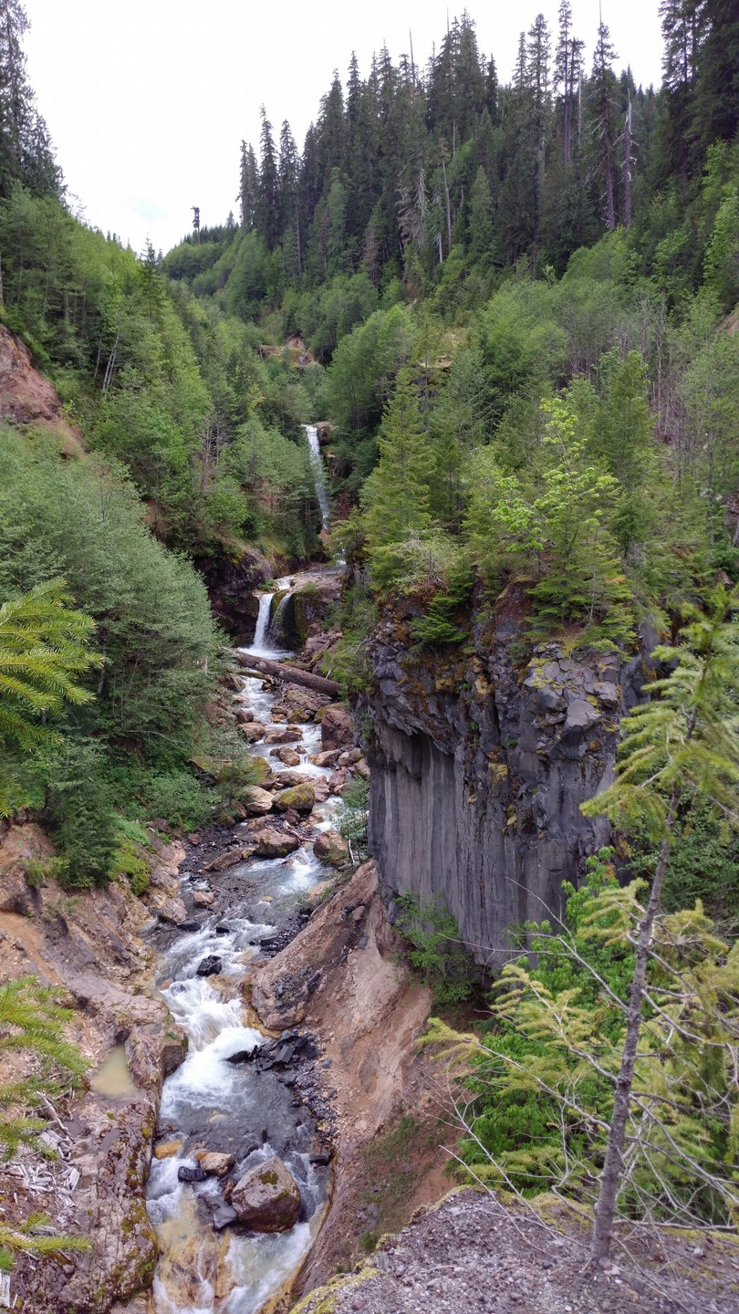
Trail #184 past the ladder
View from The Ship
Long walk for just this view
Binoculars needed

Slide 35
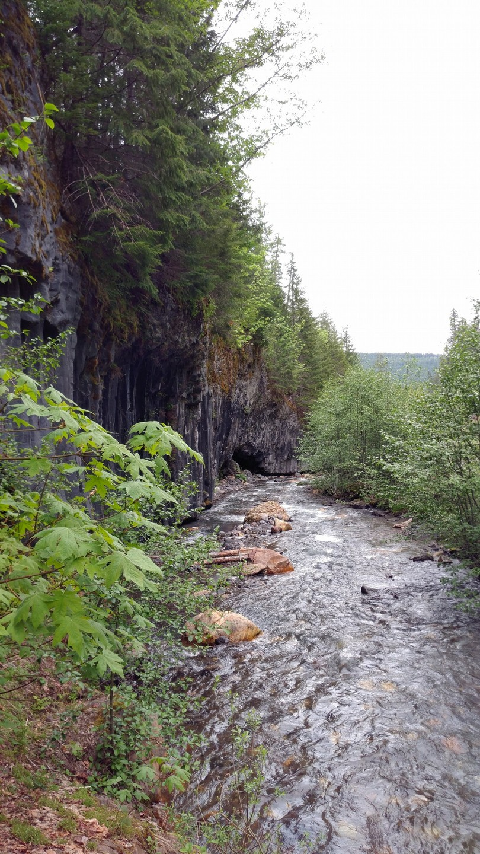
Trail #184 past the ladder
Sandbar West
Flat water
The end of the sand bar is a cliff on the west side
Could cross then access lower bridge on the east side

Slide 36
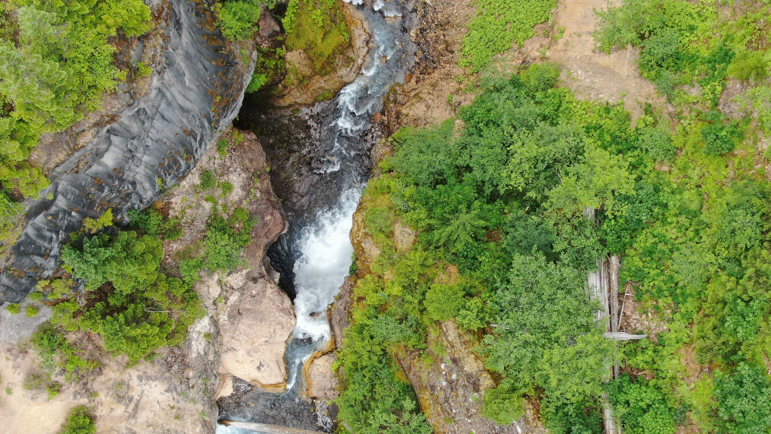
Still more to learn
Alcove found via drone flight, not visible from the ground

Slide 37
Bonus Videos
Middle Lava Canyon Falls to Lava Canyon Falls
Ship Falls to Lower Lava Canyon Falls
Suspension Bridge

Slide 38
Credits
Mapping Team
Lance Dawkins, Nate Eterno, Randy Matson, Brian Murray, Jared Smith, Mike Williams
Additional Drone Footage – Nicholas Murray
Waterfall Data – www.waterfallsnorthwest.com

